Slide 1
Logistic Regression logistic classification
Arunkumar Nair

Slide 2
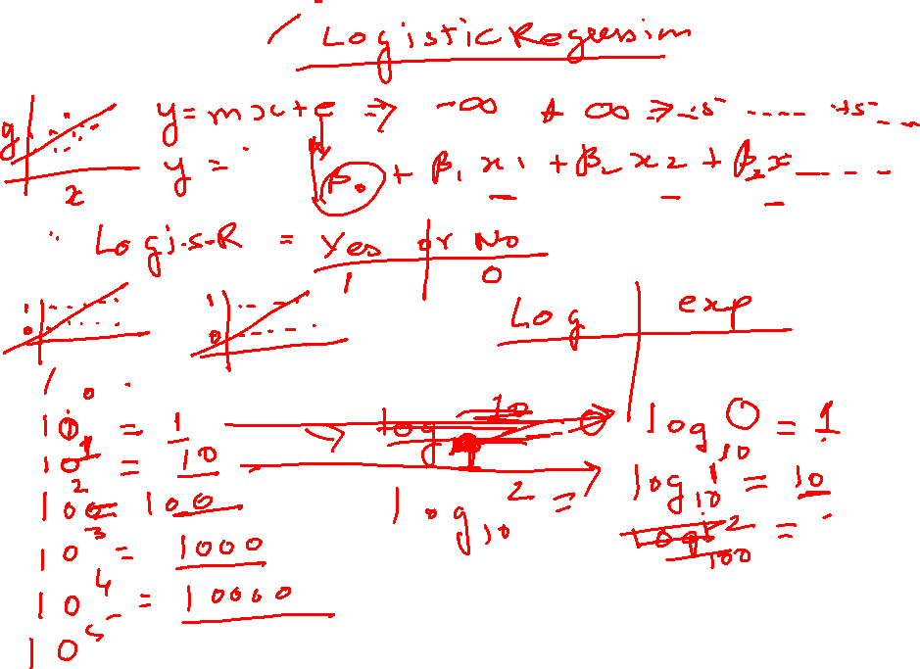

Slide 3
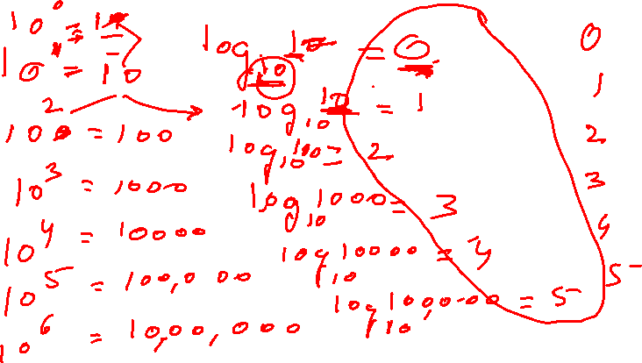

Slide 4
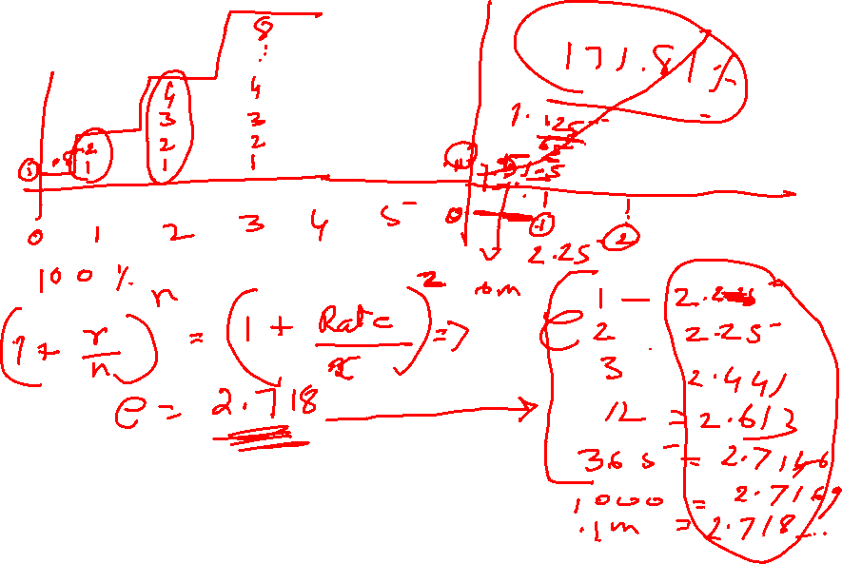

Slide 5
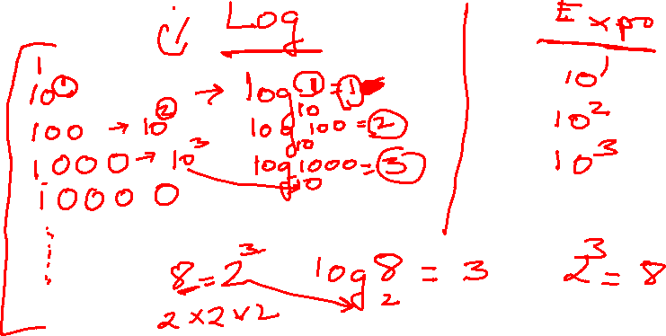
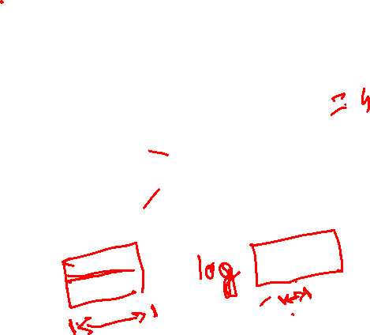

Slide 6
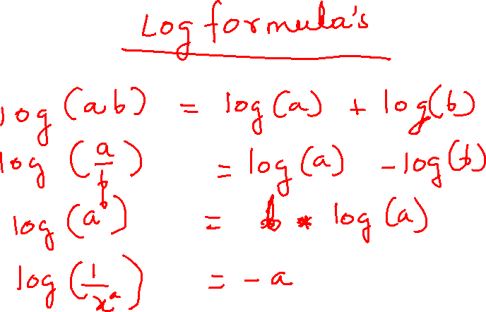
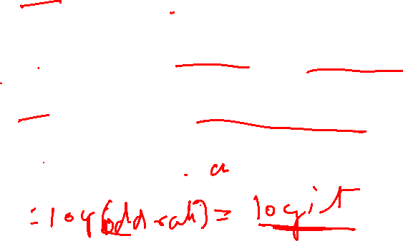


Slide 7
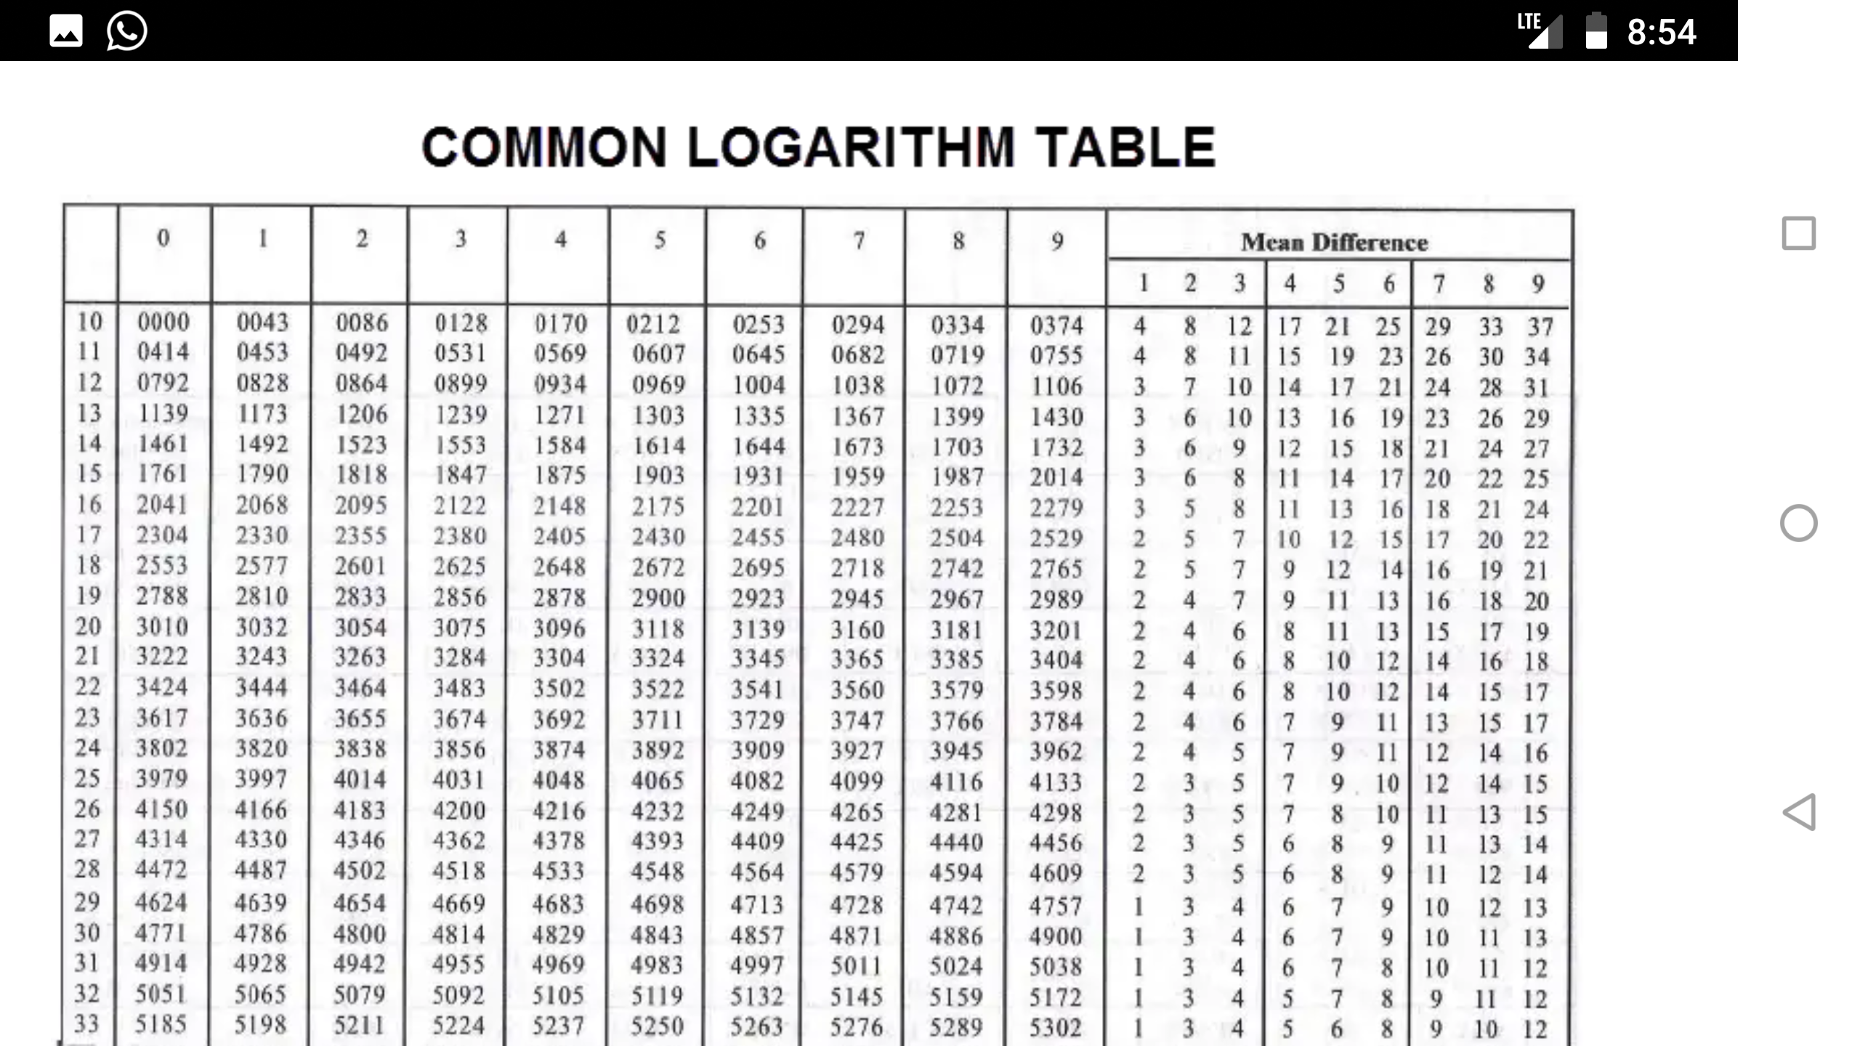

Slide 8
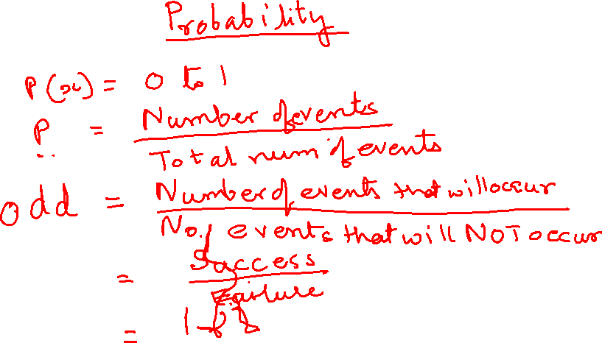
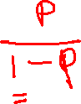

Slide 9
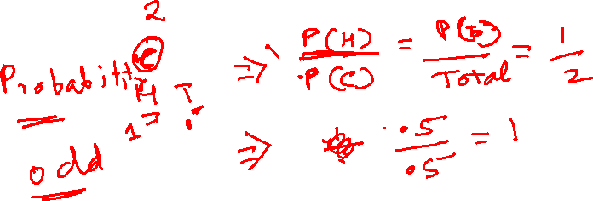
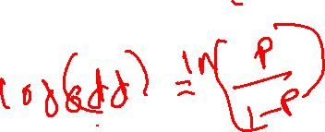

Slide 10
Logistic Regression
Logistic Regression, also known as Logit Regression or Logit Model, is a mathematical model used in statistics to estimate (guess) the probability of an event occurring having been given some previous data. Logistic Regression works with binary data, where either the event happens (1) or the event does not happen (0).

Slide 11
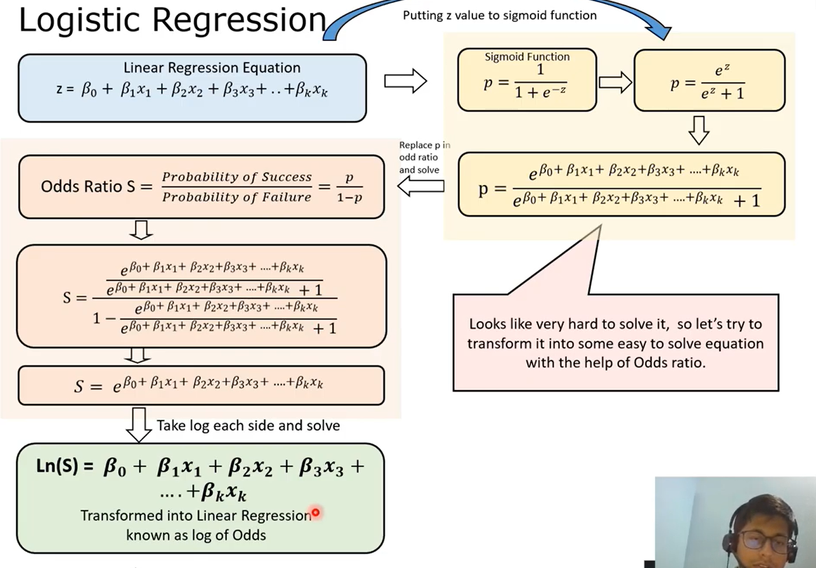
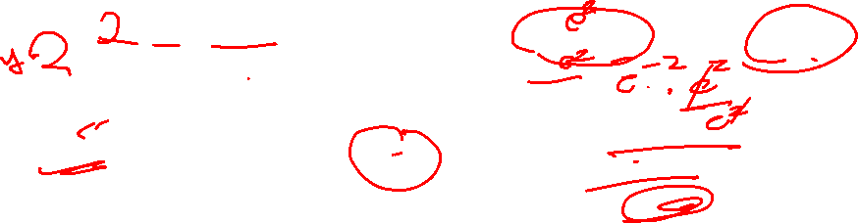

Slide 12




Slide 13

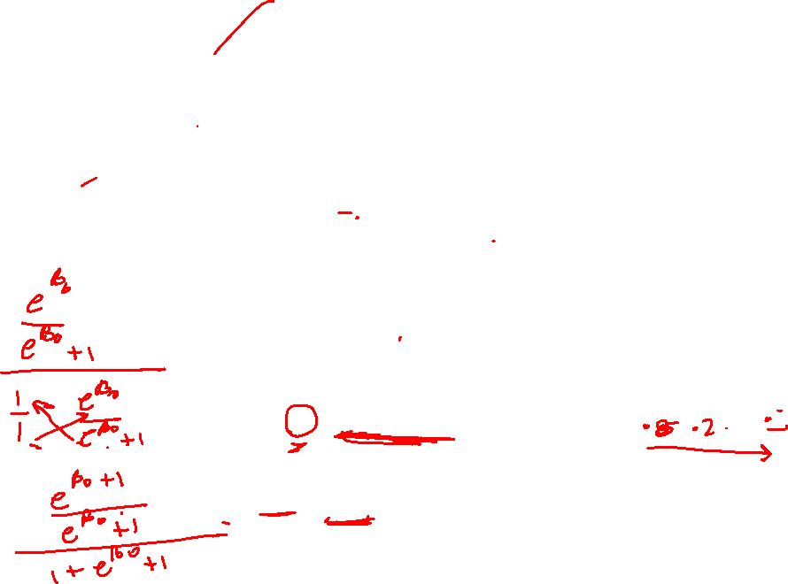

Slide 15
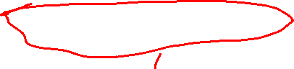
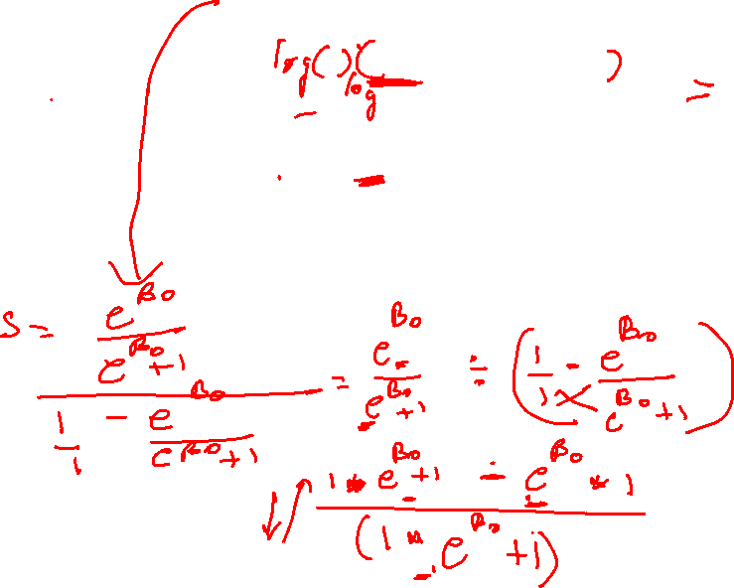

Slide 16
Case-Study Data
We are provided a sample of 1000 customers.
We need to predict the probability whether a customer of a Particular Age will buy (y) a sim card or
not.
As we’ve a categorical outcome variable, we’ll use logistic regression.

Slide 17
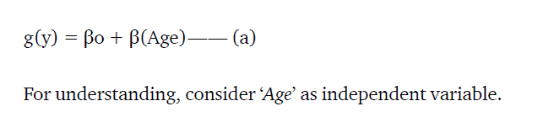
Linear to Logistic – (a)
To start with logistic regression, first write the simple linear regression equation with dependent variable enclosed in a link function:
Y = c + m X

Slide 18
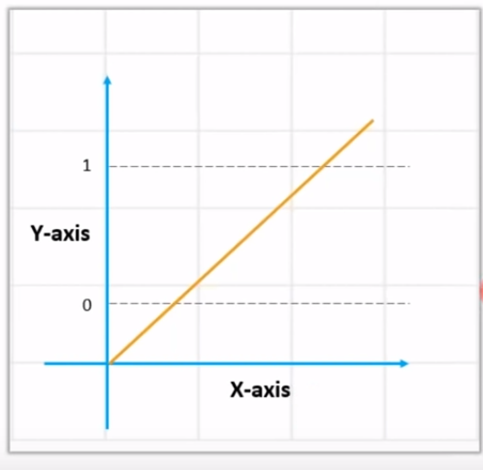
Linear Regression
+ infinity
- infinity

Slide 19
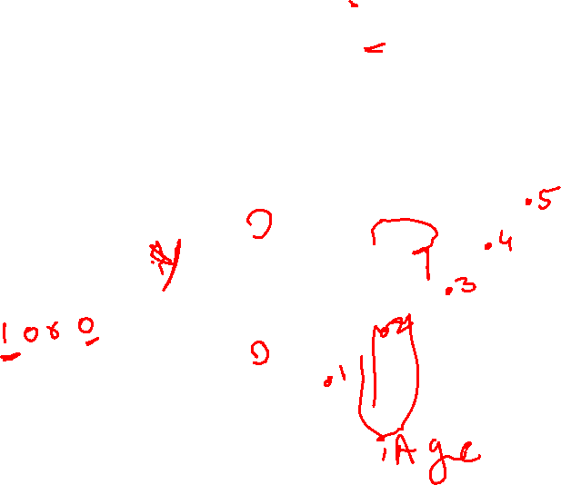
Linear Regression
+ infinity
- infinity

Slide 20
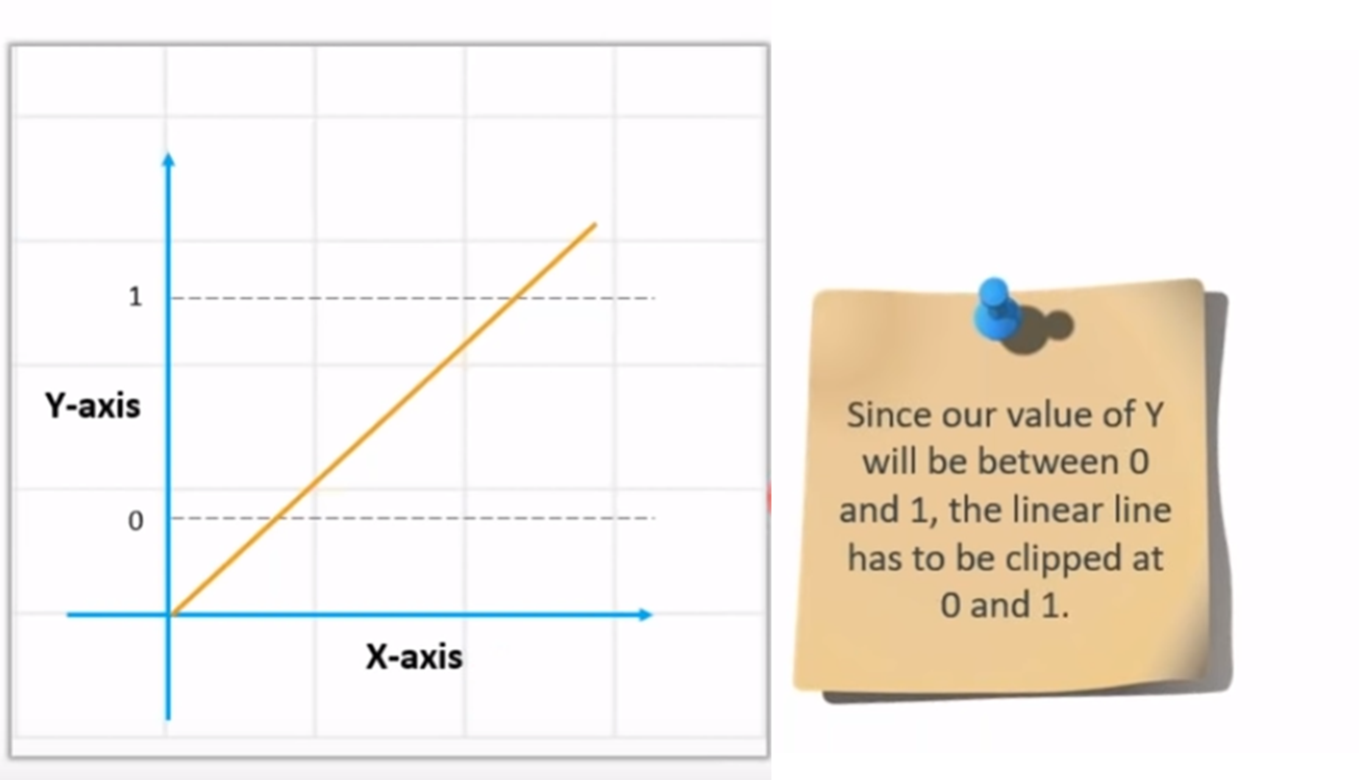
Linear regression equation: y = β0 + β1X1 + β2X2 …. + βnXn

Slide 21

Linear regression equation: y = β0 + β1X1 + β2X2 …. + βnXn

Slide 22
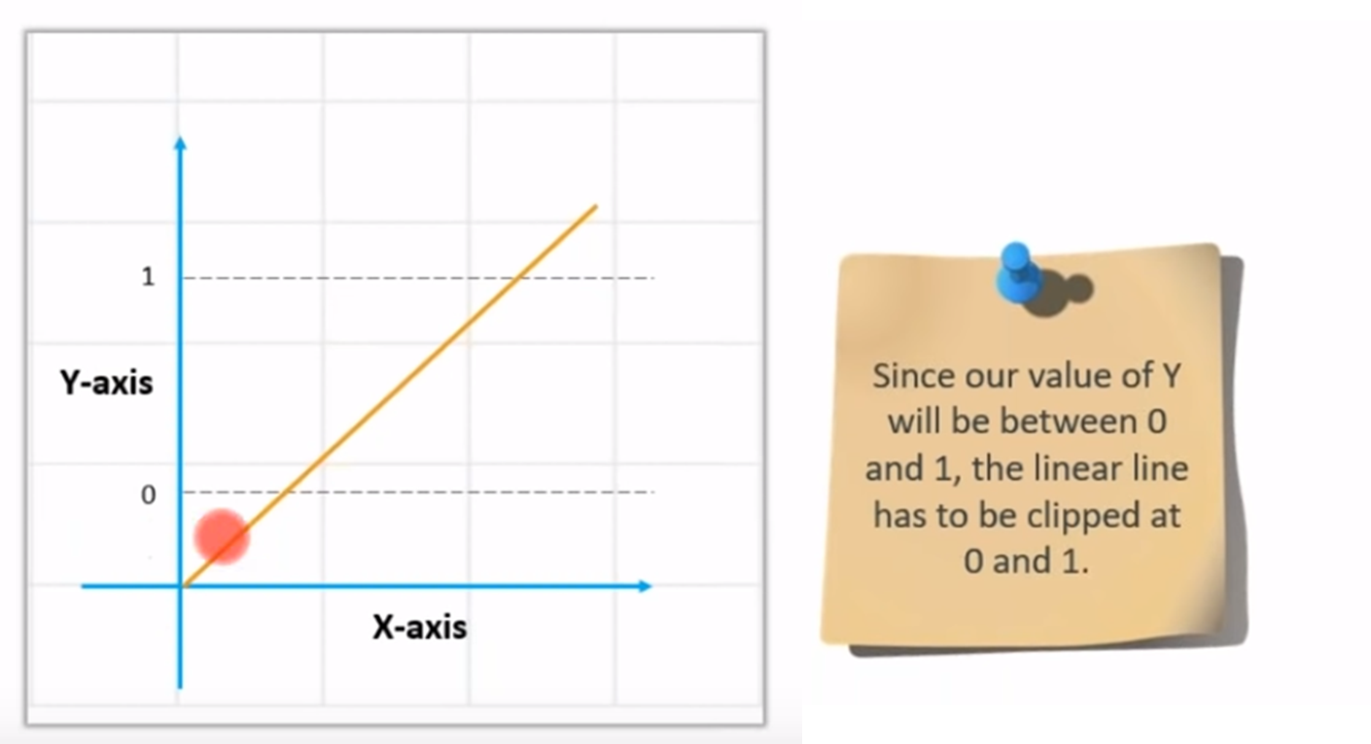
Value of Y – between 0 and 1

Slide 23
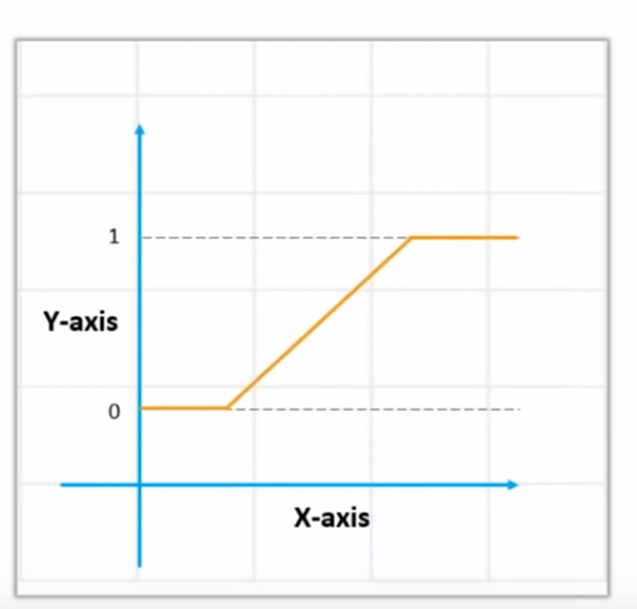
How to get the value of 0 and 1

Slide 24
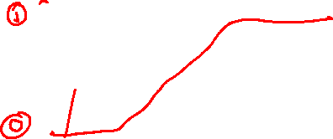
How to get the value of 0 and 1

Slide 25
How to get the value of 0 and 1? Use Sigmoid
We Apply sigmoid function on the linear regression equation to get the S-curve so that it lies between 0 and 1
Sigmoid function: p = 1 / 1 + e^{-y}
A sigmoid function is a mathematical function/equation having a characteristic "S"-shaped curve or sigmoid curve.

Slide 26


How to get the value of 0 and 1? Use Sigmoid
We Apply sigmoid function on the linear regression equation to get the S-curve so that it lies between 0 and 1
Sigmoid function: p = 1 / 1 + e^{-y}
A sigmoid function is a mathematical function/equation having a characteristic "S"-shaped curve or sigmoid curve.

Slide 27
How to get the value of 0 and 1? Use Sigmoid
We Apply sigmoid function on the linear regression equation to get the S-curve so that it lies between 0 and 1
Sigmoid function: p = 1 / 1 + e^{-y}
A sigmoid function is a mathematical function/equation having a characteristic "S"-shaped curve or sigmoid curve.

Slide 28
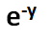
Convert Linear to Logistics
Linear regression equation: y = β0 + β1X1 + β2X2 …. + βnXn
Sigmoid function: p = 1 / 1 + e^{-y}
y is replaced
Logistic Regression equation: p = 1 / 1 + e^{-(β0 + β1X1 + β2X2 …. + βnXn)}

Slide 29


Convert Linear to Logistics
Linear regression equation: y = β0 + β1X1 + β2X2 …. + βnXn
Sigmoid function: p = 1 / 1 + e^{-y}
y is replaced
Logistic Regression equation: p = 1 / 1 + e^{-(β0 + β1X1 + β2X2 …. + βnXn)}

Slide 30
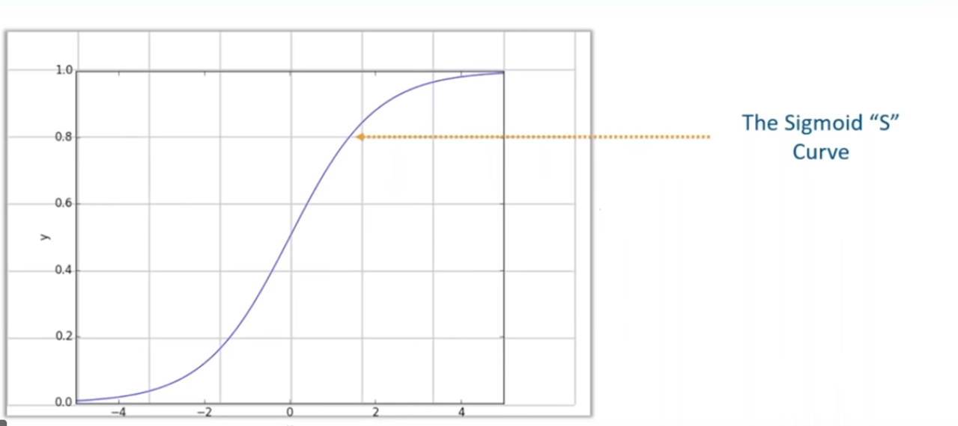
Sigmoid – S-curve

Slide 31

Sigmoid – S-curve

Slide 32

Sigmoid
Sigmoid curve converts any value from
-infinity to +infinity to (0 to 1)
Sigmoid will output:
‘0’ as x approaches −∞
‘1’ as x approaches +∞

Slide 33
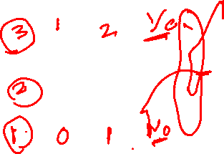
Linear Regression
+ infinity
- infinity

Slide 34
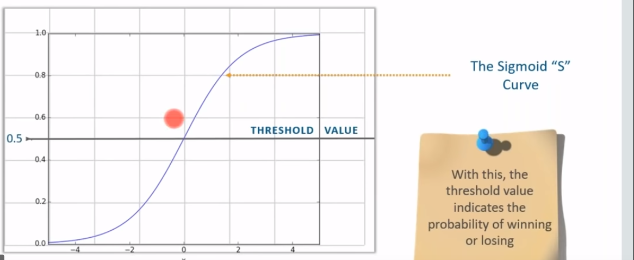

Probability values for the answers
The Threshold value
.8 becomes 1
.2 becomes 0

Slide 35
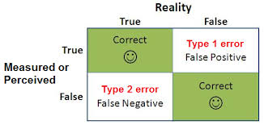

Slide 36
[[119, 11],
[ 26, 36]
Accuracy=
(TP + TN)/
(TP+TN+FP+FN)

Slide 37
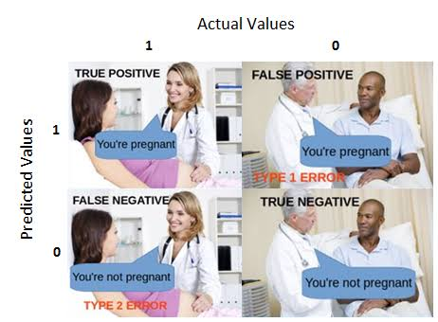
[[119, 11],
[ 26, 36]
Accuracy=
(TP + TN)/
(TP+TN+FP+FN)

Slide 38
[[119, 11],
[ 26, 36]
Accuracy=
(TP + TN)/
(TP+TN+FP+FN)
119
11
26
36

Slide 39
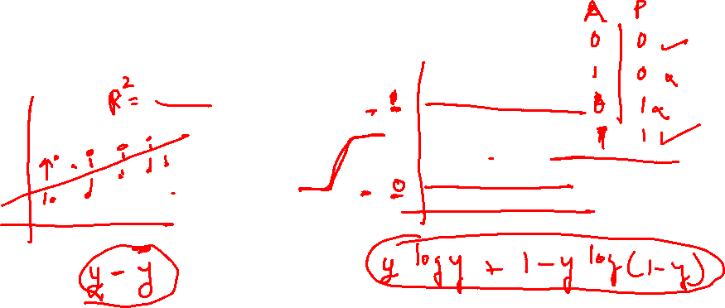

Slide 40
False Positive Rate (caused by Type I Error) Type1 Error- not to worry
Sometimes, this error might translate to a simple case where a person is predicted to have some bacterial infection while actually that might not be the case. The medication to treat simple bacterial infections might not be very dangerous and is believed to have very mild or no side effects on the patient.
So, in such cases, we might not worry much about the Type I error..

Slide 41
False Positive Rate (caused by Type I Error) Type1 Error- if it is cancer then we Need to worry
Things can get complicated and serious if Type 1 error happens in a scenario where a person not suffering from cancer is diagnosed to have cancer. This can be really dangerous and sometimes fatal due to the high doses of radiation and chemotherapy that a patient can be exposed to.

Slide 42
True Negative Rate (or Specificity)
True Negative Rate (or Specificity)is a metric that tells us how often the model predicts ‘no’ for an actual ‘no’. It is equivalent to 1 minus False Positive Rate.

Slide 43
False Negative Rate (caused by Type II Error):
Number of items the model wrongly predicted ‘no’ out of the total actual ‘yes’. This metric is especially important in most binary classification problems, as it tells us the frequency with which a positive instance is wrongly identified as negative. For example, if a cancer patient is wrongly diagnosed as not having cancer, that individual would either go undiagnosed or misdiagnosed. Similarly, identifying a fraudulent transaction as non-fraudulent can cause several serious repercussions for a bank. Hence, whenever we intend our model to be a diagnostic aid, we would always want this metric to be as low as possible.

Slide 44
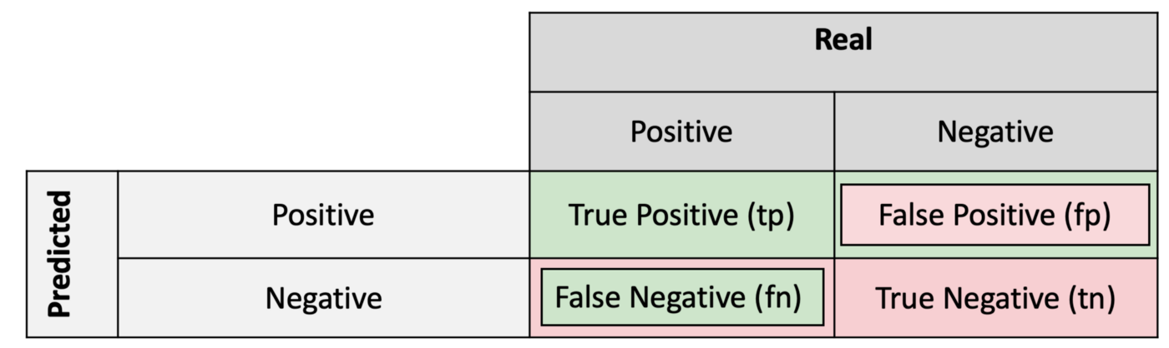
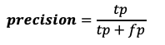
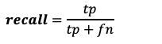
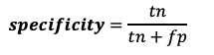
Precision — Out of all the examples that predicted as positive, how many are really positive?
positive predictive value
False Positive Rate
Recall — Out of all the positive examples, how many are predicted as positive?
Specificity — Out of all the people that do not have the disease, how many got negative results?
True Negative Rate (or Specificity)
Recall and Sensitivity are the same.
False Negative Rate

Slide 45
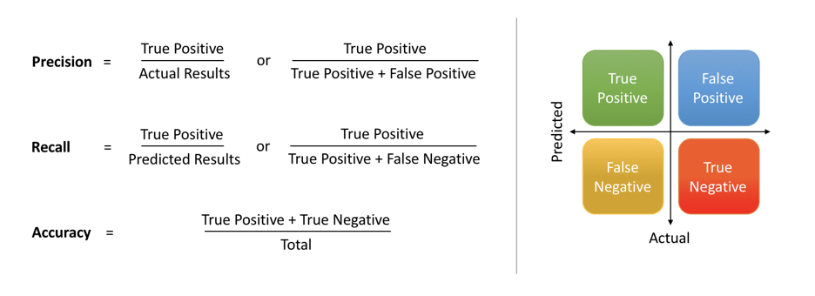
Precision — Out of all the examples that predicted as positive, how many are really positive?
positive predictive value
Recall — Out of all the positive examples, how many are predicted as positive?
Specificity — Out of all the people that do not have the disease, how many got negative results?
Recall and Sensitivity are the same.

Slide 46
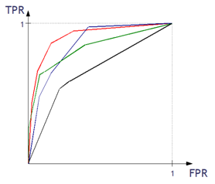
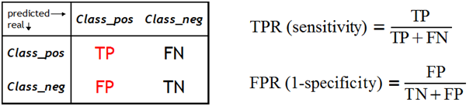
What is the ROC curve?
The Receiver Operating Characteristic (ROC) curve is one of the methods for visualizing classification quality, which shows the dependency between TPR (True Positive Rate) and FPR (False Positive Rate).
Notes:
http://algolytics.com/how-to-assess-quality-and-correctness-of-classification-models-part-4-roc-curve/
The more convex the curve, the better the classifier. In the example below, the “green” classifier is better in area 1, and the “red” classifier is better in area 2

Slide 47
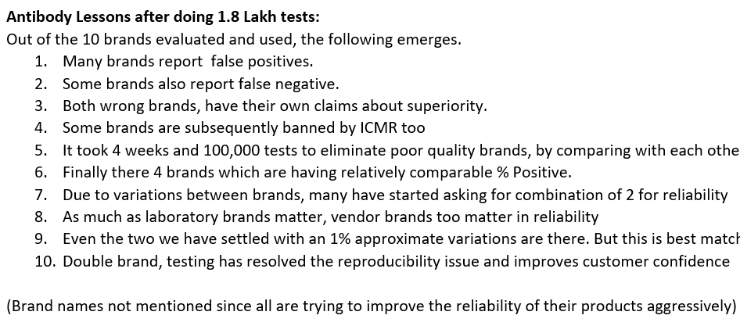
Many #AntibodyTesting kits. Some have false +ves . That affects reliability of Testing labs, and Survey results of #Seroprevalence too. #TNCAI uses two best and consistent global brandsDown pointing backhand index. Took 1L tests to fix.

Slide 48
Thanks
End

